Slide 1
Thwarting cache-based side-channel attacks
Yuval Yarom
The University of Adelaide and Data61

Slide 2
“The binary search needs to be done in constant time to avoid timing issue. But it's fast, so there's no problem.”
An anonymous reviewer, AsiaCrypt 2016

Slide 3
Outline
Introduction to cache attacks
Constant-time programming
Testing for constant-time

Slide 4
The Microachitecture
ISA
TLB
Pipeline
Microarchitecture
BPU
Instruction Cache
Data Cache
MMU
LLC
DRAM
Interconnect

Slide 5
Microarchitectural attacks
Force contention on microarchitectural components
Creating timing variations
That are used to expose an intarnal state
Which depends on secret data
Allowing the attacker to infer said data

Slide 6
Cache Structure
Stores fixed-size lines
Arranged as multiple sets, each consisting of multiple ways.
Each memory line maps to a single cache set
Can be cached in any of the ways in the set
Memory
Sets
Cache
Ways

Slide 7
The Prime+Probe attack
Choose a cache-sized memory buffer
Access all the lines in the buffer, filling the cache
Victim executes, evicting some of the buffer lines from the cache
Measure the time to access the buffer
Accesses to cached lines is faster than to evicted lines
Memory
Cache
C. Percival, "Cache Missing for Fun and Profit", BSDCan, 2005
D. A. Osvik, A. Shamir and E. Tromer, "Cache Attacks and Countermeasures: The Case of AES", CT-RSA 2006

Slide 8
Prime+Probe attack on GnuPG 1.4.13
Square
Multiply

Slide 9
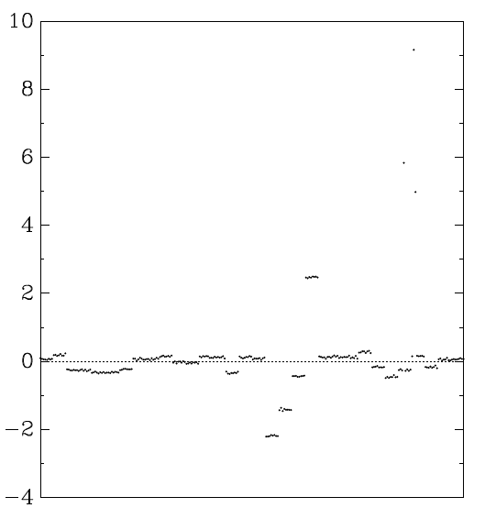
The Bernstein attack
AES tables stored in memory
Table access patterns depend on both the key and the plaintext/ciphertext
Access time depends on the pattern of previous accesses
Attack:
Create timing profiles for each key byte
Measure timing
Match with profile
Timing Profile for byte 15 [Ber05]
D. J. Bernstein, "Cache-timing attacks on AES",http://cr.yp.to/antiforgerycachetiming-20050414.pdf, 2005

Slide 10
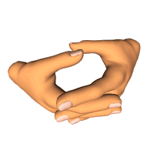
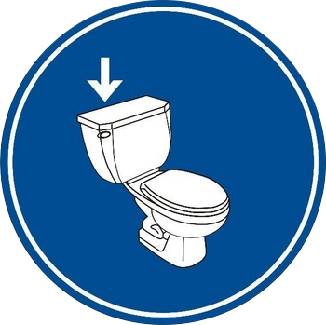
Flush+Reload
Processor
Flush memory line
Wait a bit
Measure time to Reload line
slow-> no access
fast-> access
Repeat
Cache
Memory
D. Gullasch, E. Bangerter and S. Krenn, “Cache Games - Bringing Access-Based Cache Attacks on AES to Practice”, IEEE S&P 2011
Y. Yarom and K. Falkner, “Flush+Reload: a High Resolution, Low Noise, L3 Cache Side-Channel Attack”, USENIX Security 2014

Slide 11
Flush+Reload on GnuPG 1.4.13

Slide 12
Why focus on crypto?
Because that’s where the keys are
Small code base with fairly regular operation
Narrow semantic gap between the code and the leak

Slide 13
Mitigation Strategies
System
Avoid/reduce sharing
Insert noise (e.g. noisy timers, random caches)
Software
Inject noise (e.g. blinding)
Constant-time programming

Slide 14
Constant-time programming
Execution time does not depend on any secret data
Three rules:
No instructions with data-dependent execution time
No secret-dependent flow control
No secret-dependent memory access

Slide 15
Constant-time programming in practice

Slide 16
Fix attempt #1

Slide 17
Fix attempt #2

Slide 18
Fix attempt #3

Slide 19
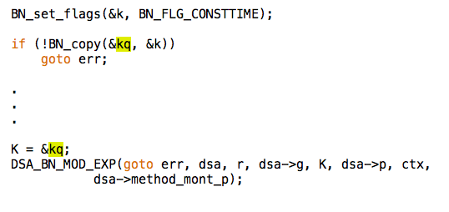
Checking for constant-time
Manual testing is not easy and is error-prone.

Slide 20
Dynamic Analysis
ctgrind
A patch against valgrind memcheck
Dynamically taints secret-dependent data
Warns on secret-dependent branches and memory access
Dynamic analysis can miss code paths
A. G. Langley, ctgrind https://github.com/agl/ctgrind

Slide 21
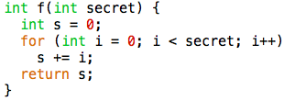
Source Analysis
FlowTracker
Uses information flow analysis to identify non-constant-time-accesses
Potential mismatch between code and binary
B. Rodrigues, F. M. Q. Pereira, D. F. Aranha, “Sparse Representation of Implicit Flows
with Applications to Side-Channel Detection”, CC 2016

Slide 22
Binary Analysis
CacheAudit
Analyses the amount of leakage from a binary given a cache model
The analysis may miss some important cache configurations
Not all of the microarchitecture is modeled
Cache banks? Branch Prediction? Cache slices?
May accept implementations that are not constant-time
G. Doychev, B.Köpf, L.Mauborgne and J.Reineke, “CacheAudit: A Tool for the Static Analysis ofCache Side Channels”, TISSEC 18(1) 2005
G. Doychev and B. Köpf, “Rigorous Analysis of Software Countermeasures against Cache Attacks”, aarXiv 1603.02187, 2016

Slide 23
What about instructions with data-dependent time?
ISA
TLB
Pipeline
BPU
Instruction Cache
Data Cache
MMU
LLC
DRAM
Interconnect

Slide 24
What about instructions with data-dependent time?
We rely on partial and misleading documentation
What if?
A vendor decide to shortcut additions or multiplications of known zeros?
Writes that do not modify the value do not result in a dirty cache line?
We need guarantees on CPU behaviour
See https://blog.cr.yp.to/20140517-insns.html

Slide 25
Summary
Microarchitectural attacks are a threat to the security of cryptographic implementations
Constant time programming is our current best defence
But we still need:
Improved proofs of correctness
Better tests for constant-time
Vendor guarantees on the hardware

